Slide 1
mPb Contour Detection
Final Project for CSCI 4830
By Connor Thompson

Slide 2
A Brief History
Edge vs Contour
Edge: An abrupt change in some low-level image feature (i.e. Intensity)
Contour: A boundary, change in ownership from one object/surface to another.
Pb Detector
2004 - David R. Martin, Charless C. Fowlkes, Jitendra Malik
“Estimate the posterior Probability of a Boundary passing through the center point... [in a given image patch]”.
Look for contours over multiple feature channels over a range of orientations and scales.
Cutting-Edge for the time
https://www2.eecs.berkeley.edu/Research/Projects/CS/vision/grouping/papers/mfm-pami-boundary.pdf

Slide 3
mPb Extension
2010 – Pablo Arbelaez, Michael Maire, Charless Fowlkes, Jitendra Malik
“Multiscale Extension of the Pb detector”
Generate gradients for image features at multiple scales, then combine into one signal.
Allows for fine + coarse detection
One faucet of cutting-edge gPb detector
sPb being the other faucet, which builds off mPb
https://www2.eecs.berkeley.edu/Research/Projects/CS/vision/grouping/papers/amfm_pami2010.pdf
Notes:
Note: original Pb attempted to work at multiple scales, but did not see any improvement gains. Possibly because of small image size and poor choice of scales.
Source: “M. Maire, P. Arbela ́ez, C. Fowlkes, and J. Malik, “Using contours to detect and localize junctions in natural images,” CVPR, 2008.”

Slide 4
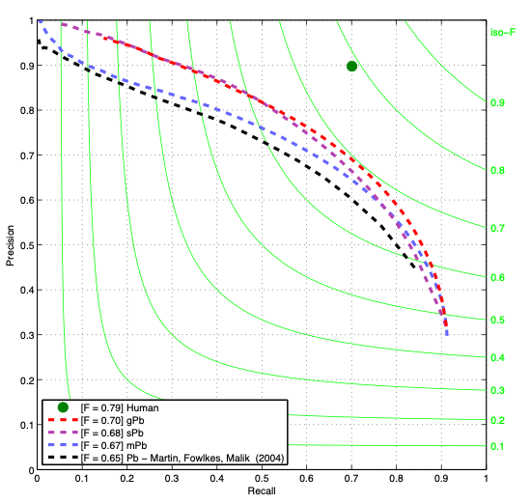
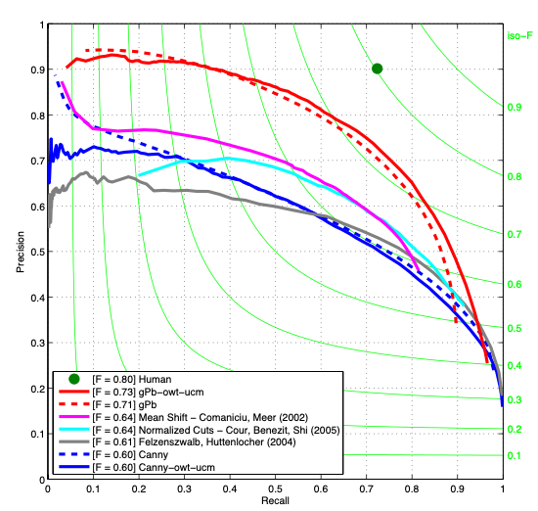
Contour (dotted lines) & Segmentation (solid lines) Detection
Contour Detection
https://www2.eecs.berkeley.edu/Research/Projects/CS/vision/grouping/papers/amfm_pami2010.pdf
Notes:
OWT = Oriented Watershed Transform -> Determines initial regions for contour map output to segmentation
UCM = Ultrametric Contour Map -> With OWT gives you a hierarchichal region tree
Image on left trained from BSDS300
Image on right trained from BSDS500

Slide 5
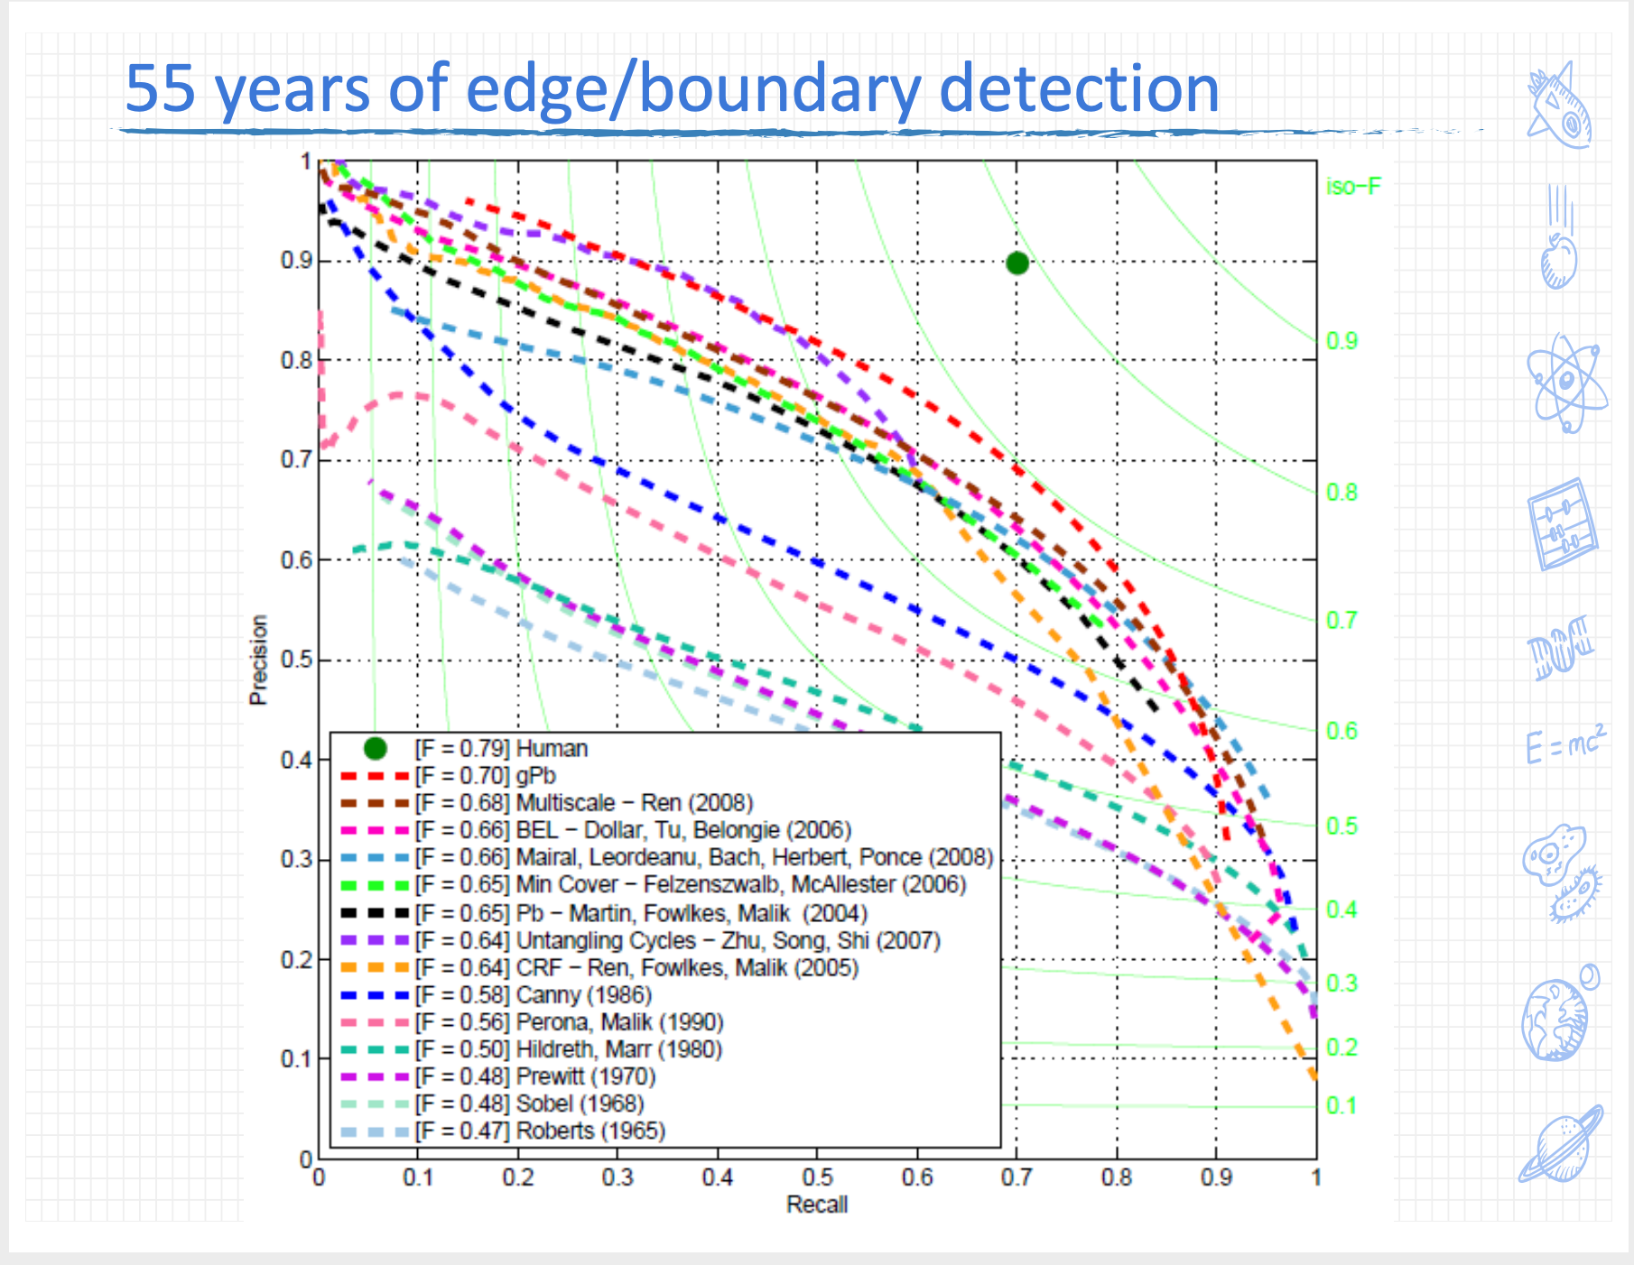
Motivation
Wanted to implement something from research
Lecture 12
https://github.com/MarkMoHR/Awesome-Edge-Detection-Papers
One of the few without heavy machine learning
Fairly straightforward research paper
Great results – some of the best without ML (so far…)
Notes:
Lecture 12 had a nice chart, gave me the idea to do edge detection. Research paper was easy to understand + didn’t require much machine learning.

Slide 6
How it Works – Step 1 Generate Filter Bank
8 oriented even and odd symmetric Gaussian Derivative filters + 1 difference of Gaussian filter
I skipped out on the DOG filter :(
Generate at 3 scales (19, 27, 39) – total of 48 filters
Generated with code from original paper linked here: https://www2.eecs.berkeley.edu/Research/Projects/CS/vision/grouping/resources.html
Notes:
Skipped DOG filter because of size inconsistencies I didn’t want to deal with given my limited work time.

Slide 7
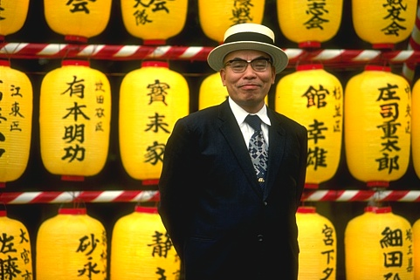
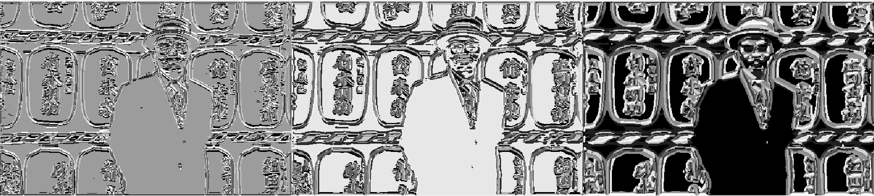
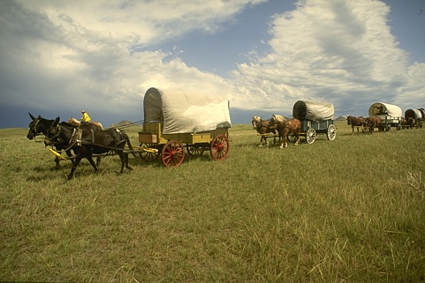
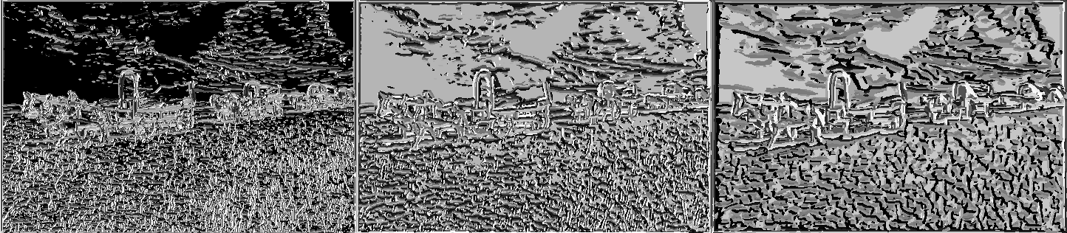
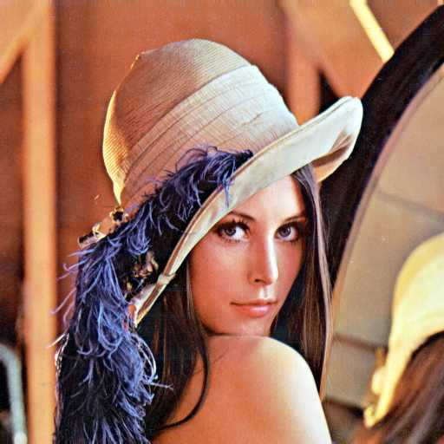
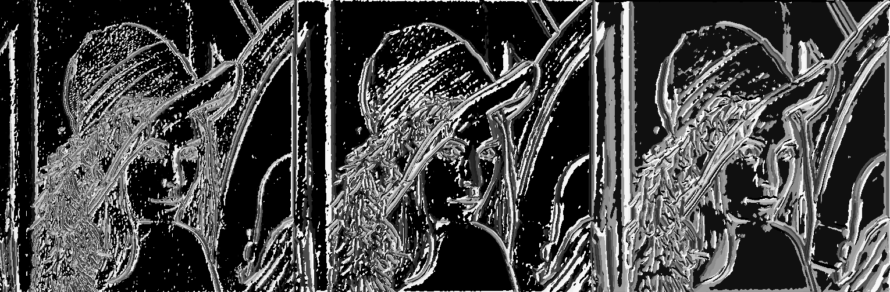
How it Works – Step 2 Convolve + Cluster
Convolve each filter with your image, K-Means Cluster results to generate local image textons
Can alternatively make global texton database
Notes:
Images shown are: [original image, small filter results, medium filter results, large filter results]

Slide 8
How it Works – Step 3 Add Intensity Information
Add Intensity information from inputted grayscale image to our results

Slide 9
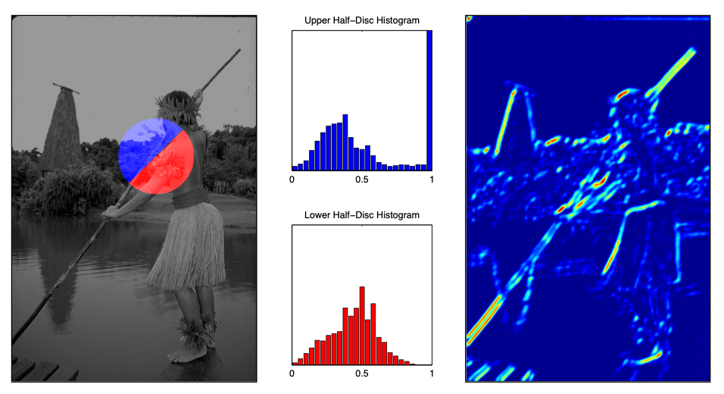
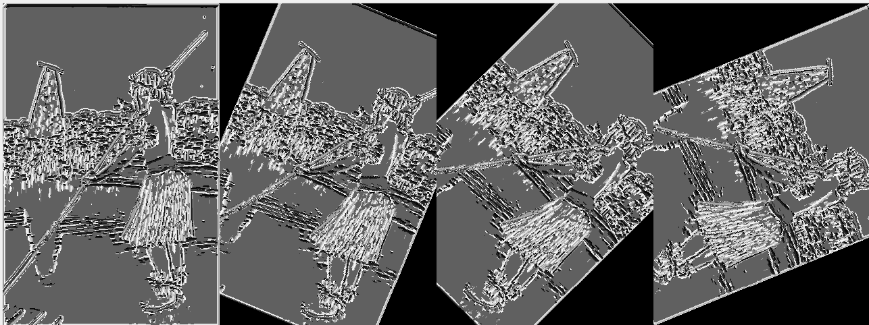
How it Works – Step 4 Pre-Rotate Features in 8 Orientations
Normally, take oriented difference of two semi-circles centered at each pixel.
To save computation time, we can pre-rotate the image in each orientation we want. To further simplify, we can use rectangles instead of circles to approximate.
Covered in Appendix of research paper, greatly reduces time complexity.
O(Nr²) → O(NB)
N = pixels, r = radius, B = Bins in histogram
https://www2.eecs.berkeley.edu/Research/Projects/CS/vision/grouping/papers/amfm_pami2010.pdf

Slide 10
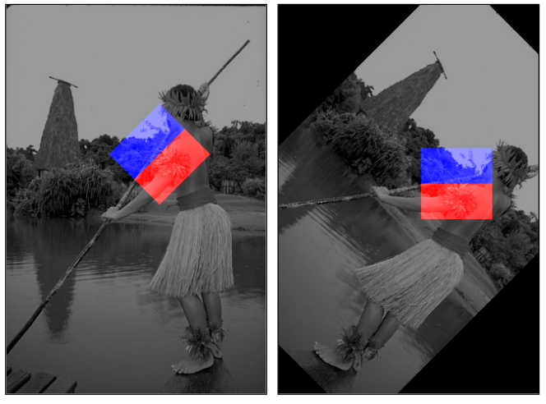
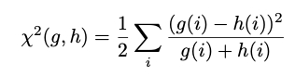
How it Works – Step 5 Take Histogram Differences
Go over each pixel in each pre-rotated feature map, take rectangle matching our filter sizes around it.
Histogram each half of the rectangle, calculate chi-square distance between resulting bins.
https://www2.eecs.berkeley.edu/Research/Projects/CS/vision/grouping/papers/amfm_pami2010.pdf

Slide 11
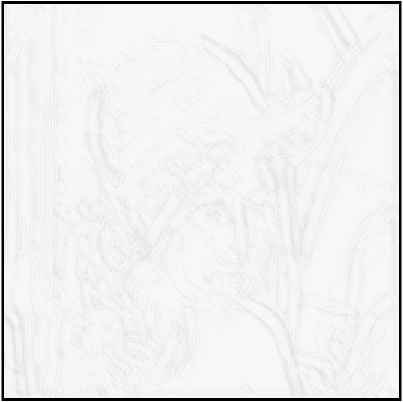
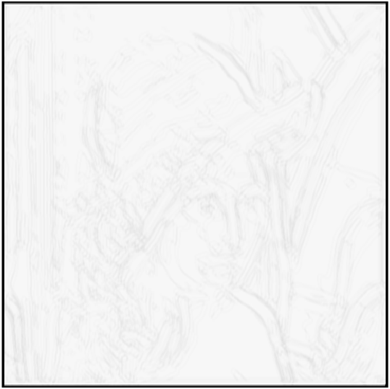
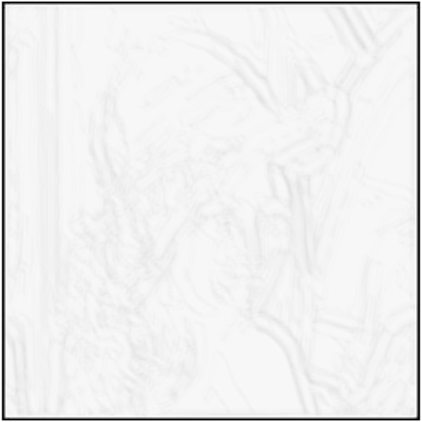
How it Works – Step 6 Apply 2nd Order Savitzky-Golay Filtering to Histogram Differences
1D is included in the Matlab Signal Processing Toolbox.
Tried both 1D and 2D, didn’t create much difference (authors used 2D)
Pre-Filter, 1D filter, and 2D filter shown below respectively
Enhances Local Minima and Smooths Detection Peaks

Slide 12
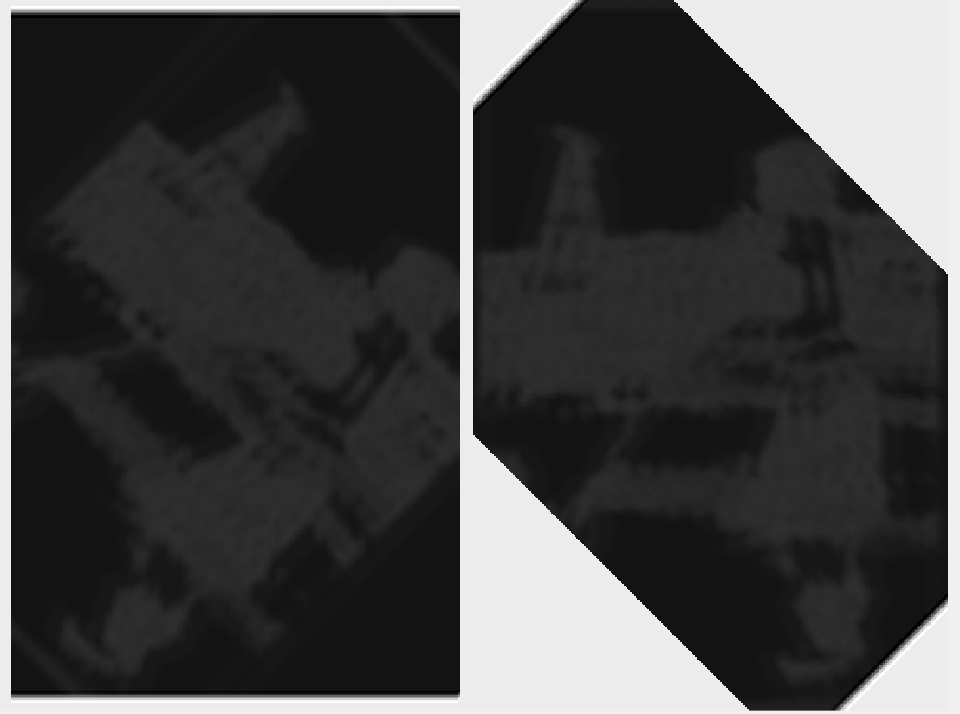
How it Works – Step 7 Rotate Results back into Place
Go through the filtered results for each feature, orientation, and scale and rotate it back into place

Slide 13
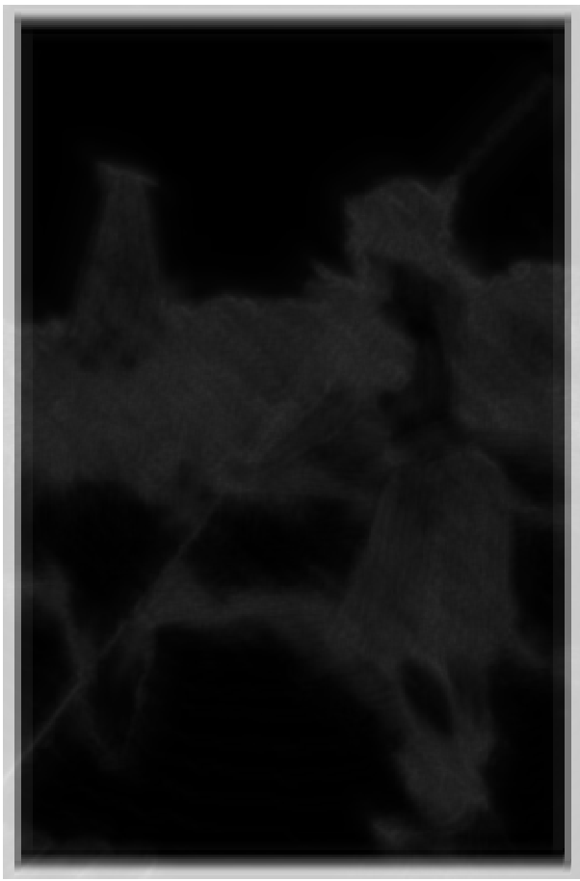
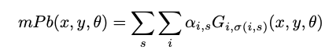
How it Works – Step 8 Create mPb(x, y, θ)
Combine gradients from each feature at each scale + orientation
Features: Textures at 3 scales + Intensity at 1 scale
Weights learned by comparing my results to ground truth segmentation data from Berkeley Segmentation Data Set (BSDS)
50/50 random weights/explore close variation of best weights
Only 10 images used (computational power limit)
Results: Gradients for our image based on all of our features, organized by the angle they were calculated at.
https://www2.eecs.berkeley.edu/Research/Projects/CS/vision/grouping/papers/amfm_pami2010.pdf
mPb(:, :, 0)

Slide 14
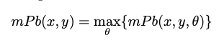
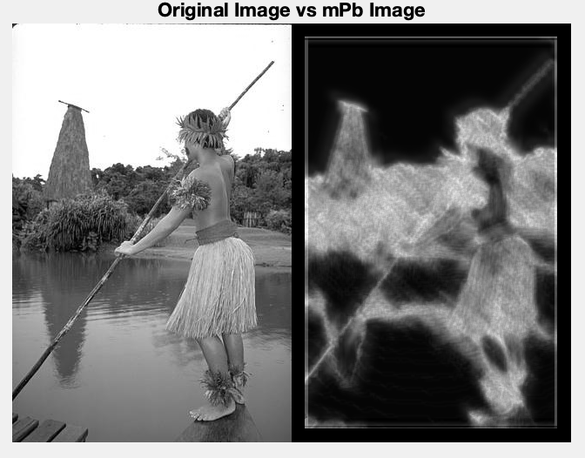
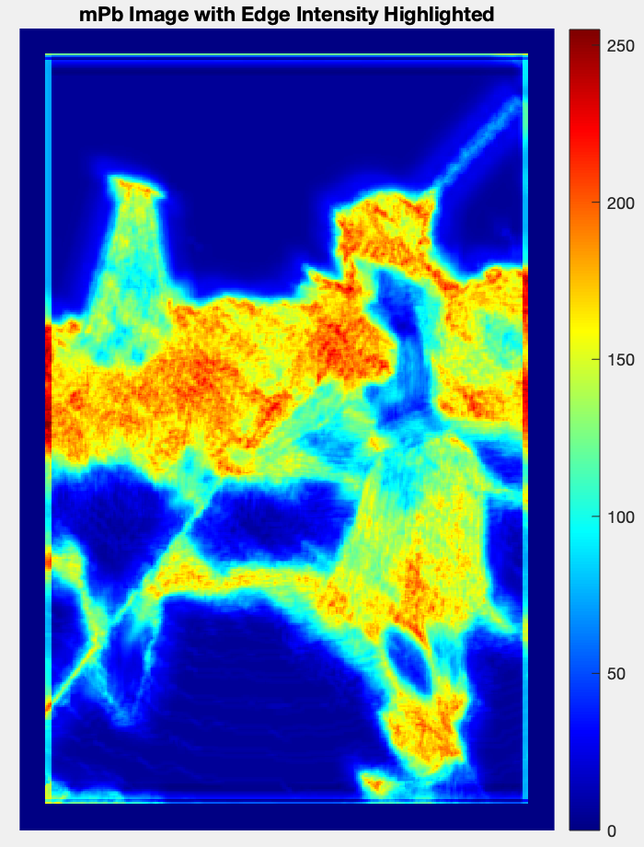
How it Works – Step 9 Reduce mPb(x, y, θ) to mPb(x, y)
Create final image by taking max of the gradient at each orientation

Slide 15
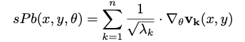
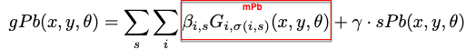
Extensions
Spectral Pb (sPb) – Extends mPb to include globalization information
Convolve Eigenvectors with our filters
Compared to mPb, filters only “fire” on the strongest curves. mPb ”fires” on all.
Global Pb (gPb) – Combine information from mPb and sPb
”Global Probability Boundary”
https://www2.eecs.berkeley.edu/Research/Projects/CS/vision/grouping/papers/amfm_pami2010.pdf

Slide 16
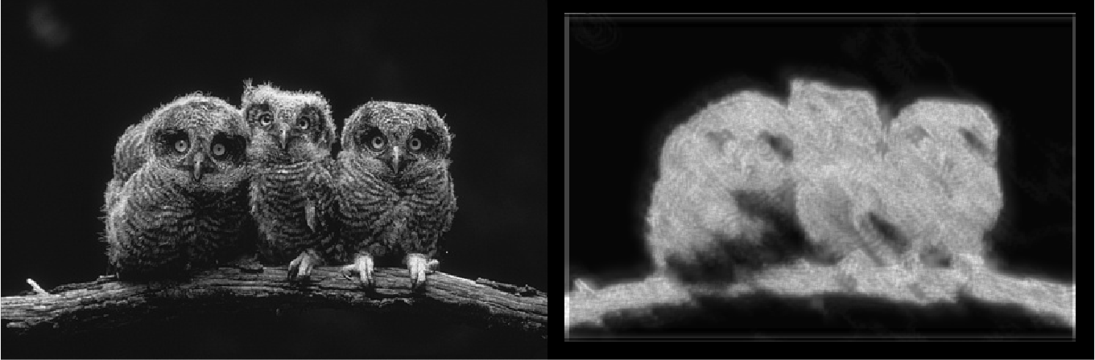
Results

Slide 17
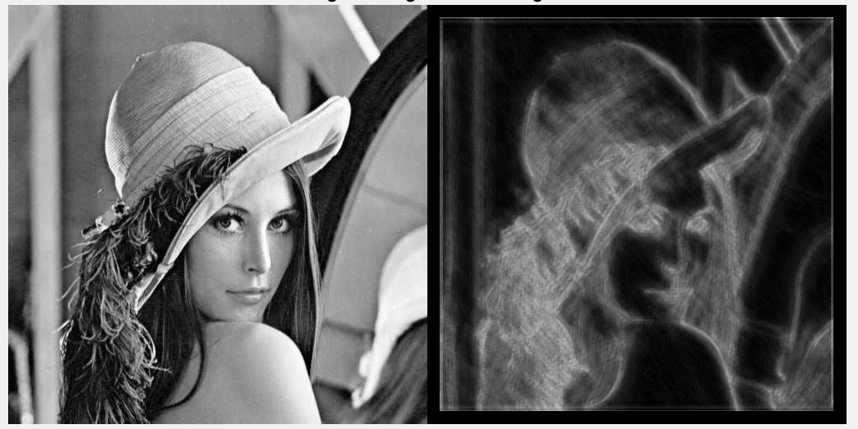
Results

Slide 18
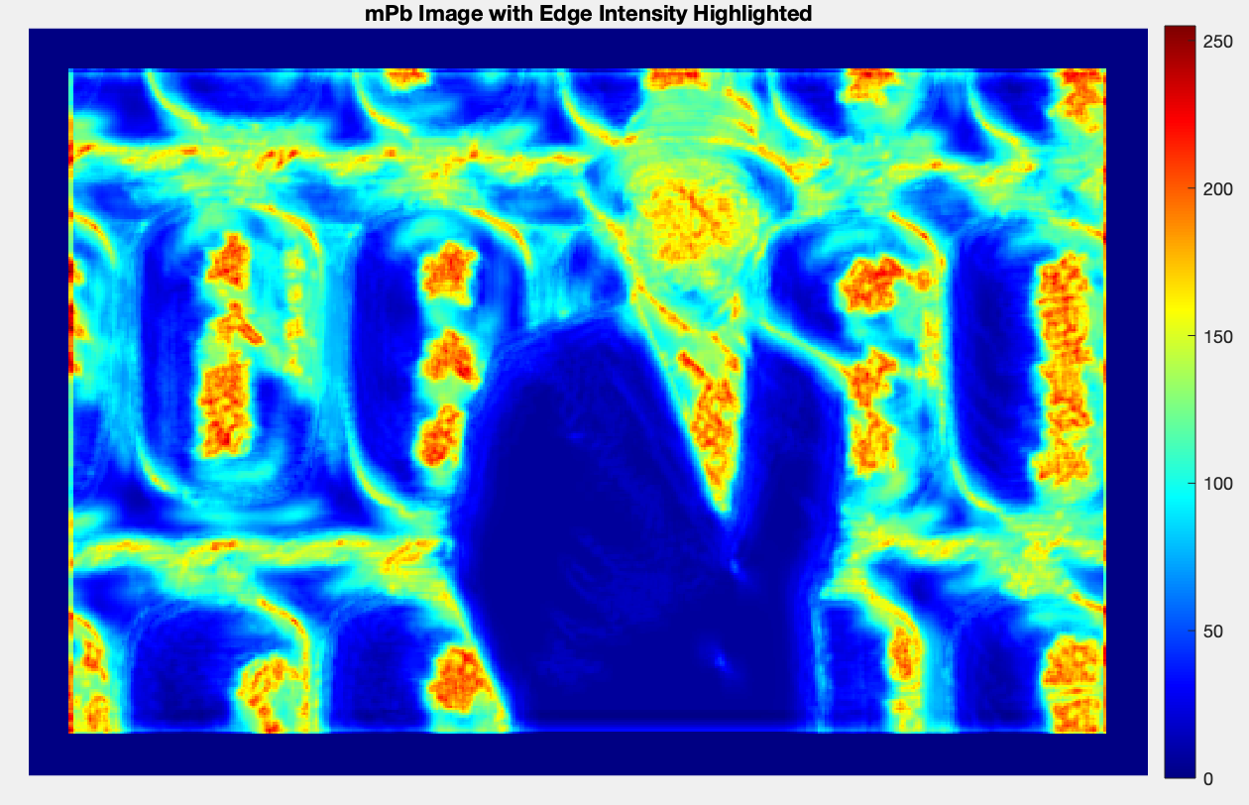
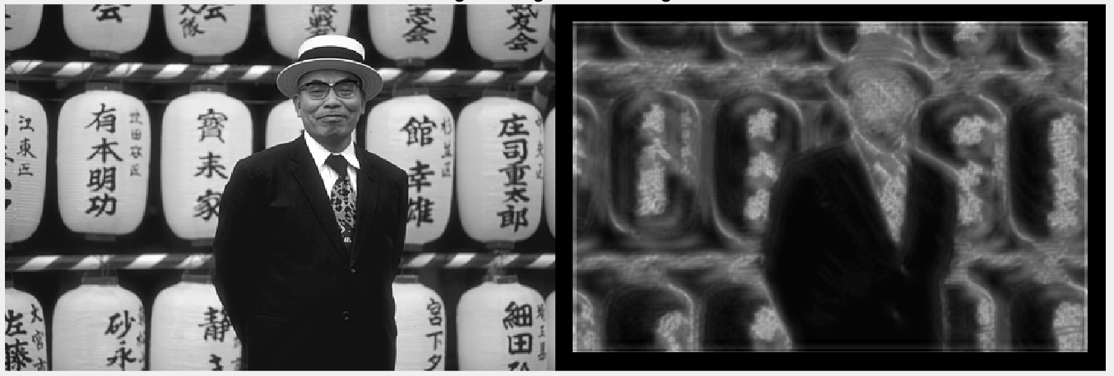
Results

Slide 19
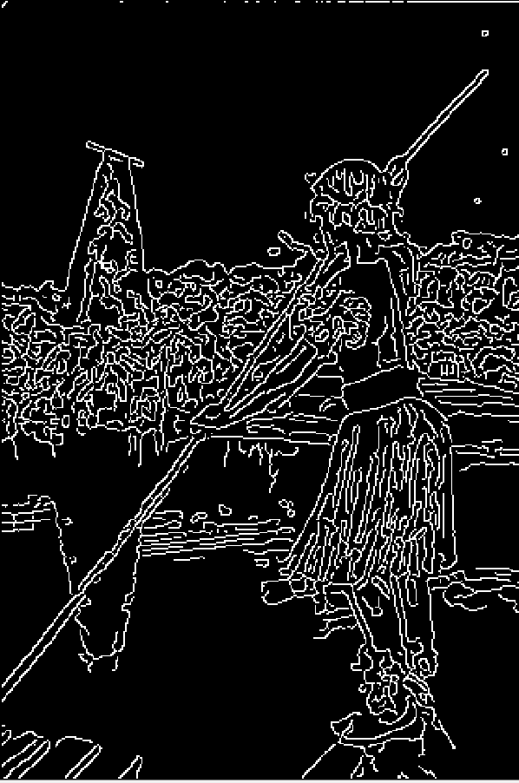
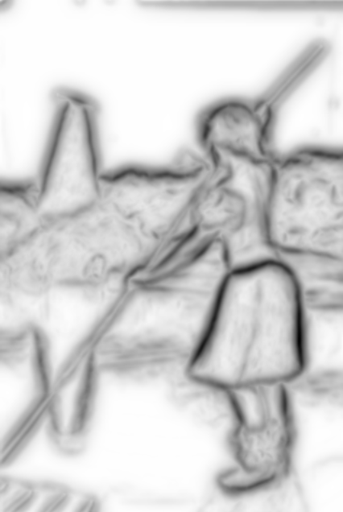
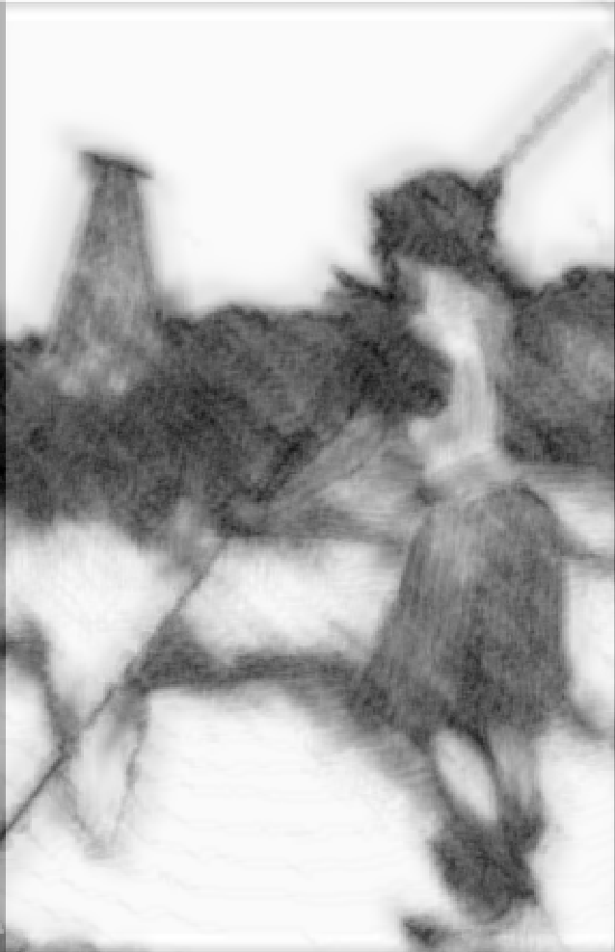
vs Canny vs Paper Results
My Results
Built-in MatLab Canny Detector
Results from Paper

Slide 20
Improvements
Include sPb/gPb
1
More training
2
Both rounds + data
Train on F-Score instead of SSD
Use Global Texton bank
3
Thresholding of some sort to eliminate noise
4
Include global information, much less noise.
Better Filtering
5
Notes:
Not as good of results as the research paper, but these I think are the improvements that would give me identical results to the research paper.

